Slide 1
Deep Neural Networks
Building blocks of
deep neural networks

Slide 2
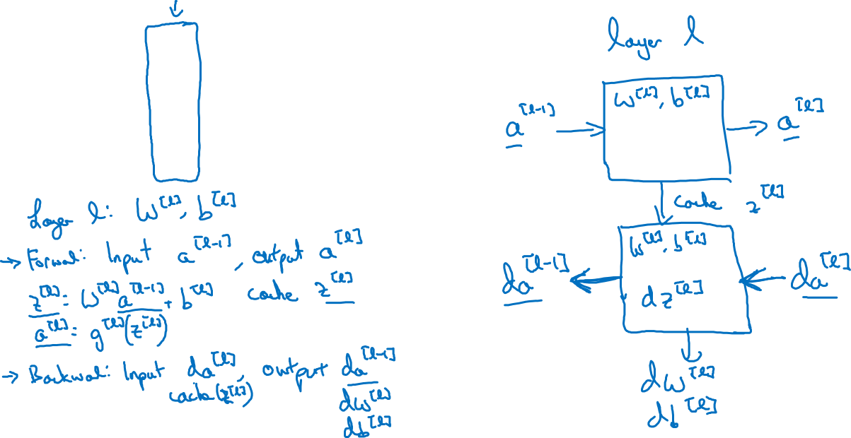






Forward and backward functions
$$x_{1}$$
$$x_{2}$$
$$\hat{y}$$
$$x_{3}$$
$$x_{4}$$

Slide 3
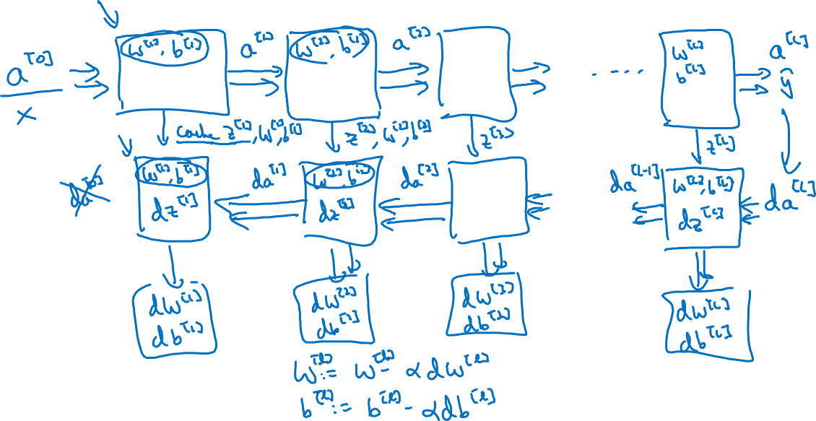
Forward and backward functions

Slide 4
Deep Neural Networks
Forward and backward
propagation

Slide 5
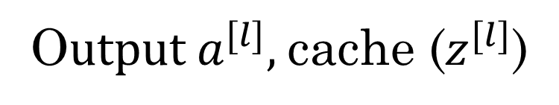
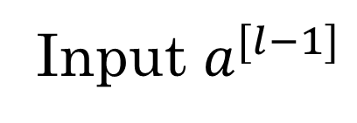
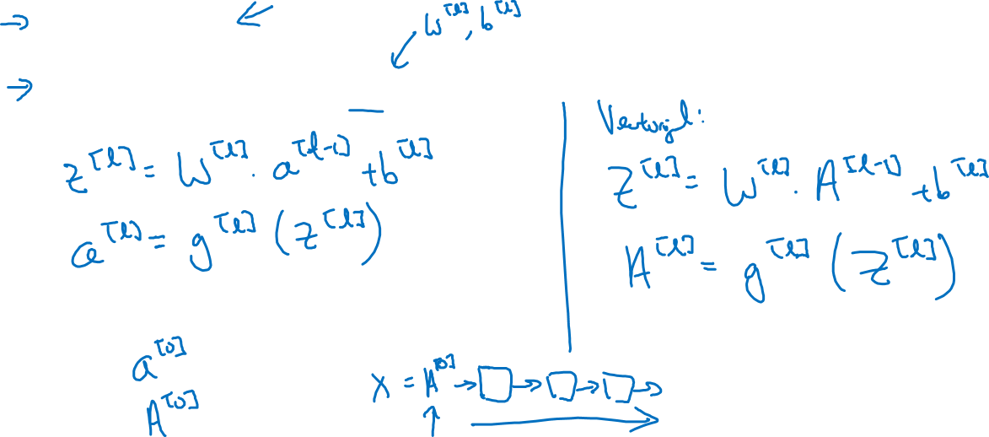
Forward propagation for layer l
Input $a^{[l−1]}$
O$utput a^{[l]},$cache ($z^{[l]}$)

Slide 6
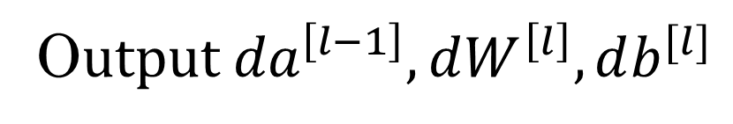
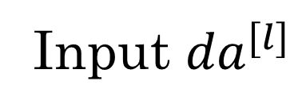
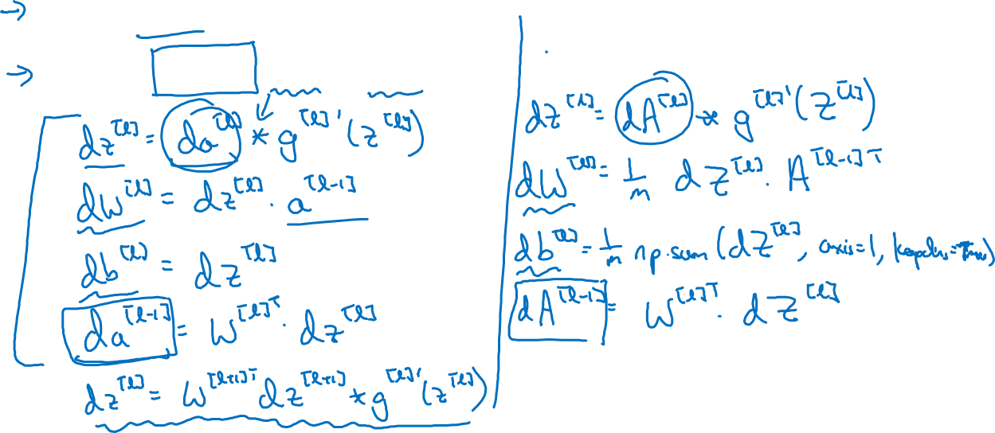
Backward propagation for layer l
Input ${da}^{[l]}$
O$utput {da}^{\left[l−1\right]},dW^{\left[l\right]},db^{[l]}$

Slide 7
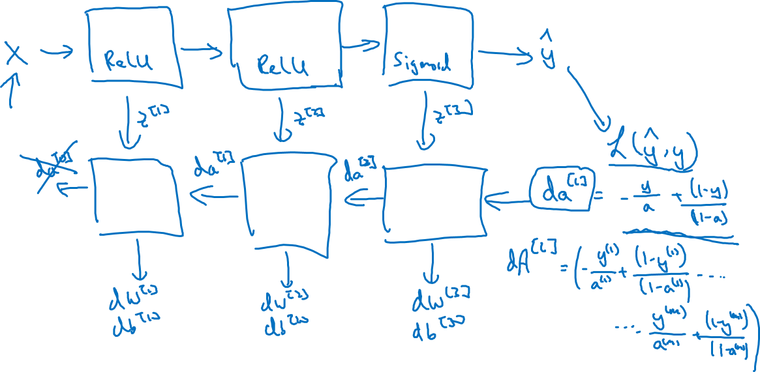
Summary

